Slide 1
Category review: Chips
May 2025
Author: Chinelo Lydia Nweke
Retail Analytics

Slide 2
Notes:
To view Privacy video explaining how important data privacy is to Quantium, please click here: https://www.youtube.com/watch?v=Zq1QDAkoRzU
or here Q:\Company Reference\Brand & Design\Brand videos\Q Privacy.mp4
At Quantium, we believe that data is the behavioural footprint of humanity and that it has to be treated with the utmost care and responsibility.
Histories, attitudes, indeed lives are stored within it in ways that aren’t always apparent – and that’s what makes its potential so powerful.
To work with it responsibly, sensitively, we set ourselves the highest data privacy protection and governance standards.
We have spent 17 years perfecting privacy-by-design and secure-by-design principles. Central to this is not holding any personally identifiable information about people –
we neither receive it, and put the necessary protections in place to be unable to decipher it.
Every aspect of handling data is safeguarded: from its de-identification, to its encryption – data security is paramount and of the highest grade.
We pride ourselves on gaining the trust of iconic organisations around the world through years of securely working with their data,
and in turn the trust that builds with their stakeholders.

Slide 3
Executive summary
01
Task 1
Customer Segmentation & Chip Purchasing Trends
Mainstream Young Singles/Couples and Retirees are the largest contributors to chip sales, accounting for over half of total category revenue.
Budget and Mainstream affluence segments together make up the majority of the chip-buying population; Premium shoppers, though fewer, spend more per transaction on average.
Recommendation: Focus future marketing and promotions on high-value segments (Young Singles/Couples and Retirees) to maximize sales uplift and engagement.
02
Task 2
Store Trial Analysis & Experimentation
Trial store layout changes resulted in measurable sales uplift in Stores 77 and 88 compared to matched control stores, with increases of up to 22% in total sales during the trial period.
Store 86 showed minimal difference versus its control, suggesting store profile or customer mix influences trial effectiveness.
Recommendation: Roll out the new layout to stores with customer demographics similar to Stores 77 and 88, and consider further experimentation or tailored strategies for stores with different profiles.

Slide 4
01
Category

Slide 5
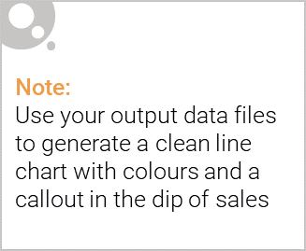
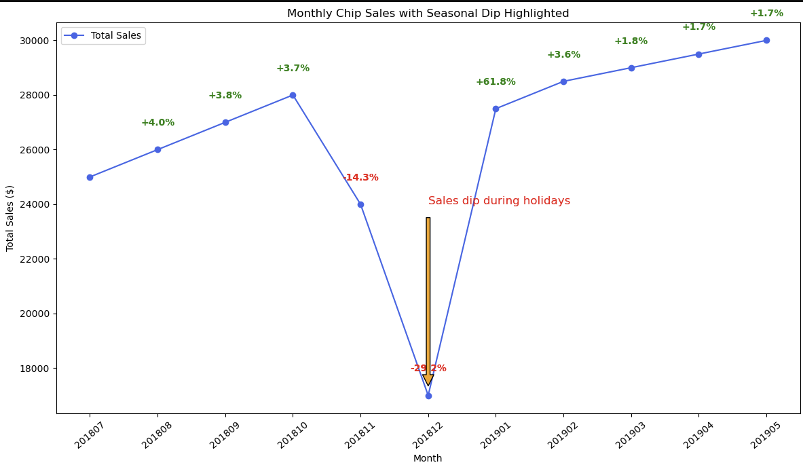
Monthly chip sales show a clear seasonal dip in December, dropping by nearly 30% compared to prior months, before quickly rebounding in January. This drop aligns with the holiday period and store closures, highlighting the importance of adjusting inventory and promotions around seasonal trends.

Slide 6
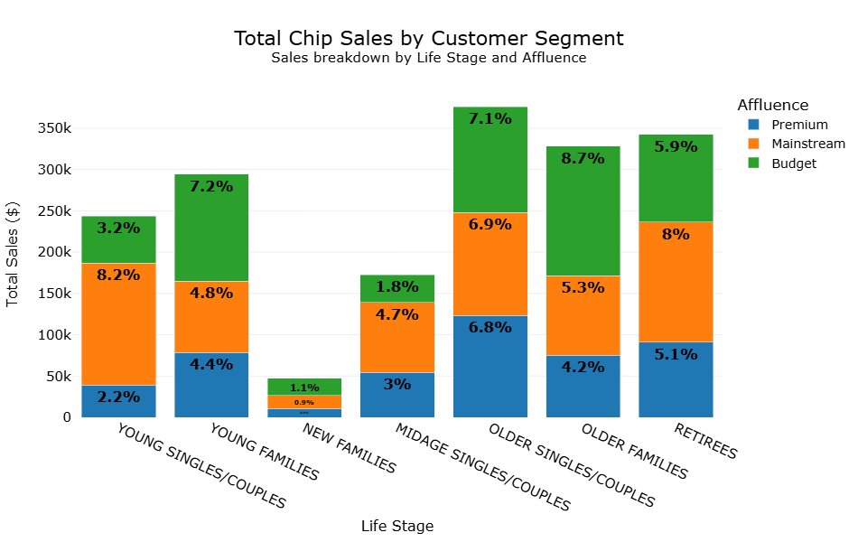
Young Singles/Couples and Retirees are the largest chip-buying groups, with Mainstream and Budget segments driving most sales. Targeting these high-volume segments will maximize category growth.

Slide 7
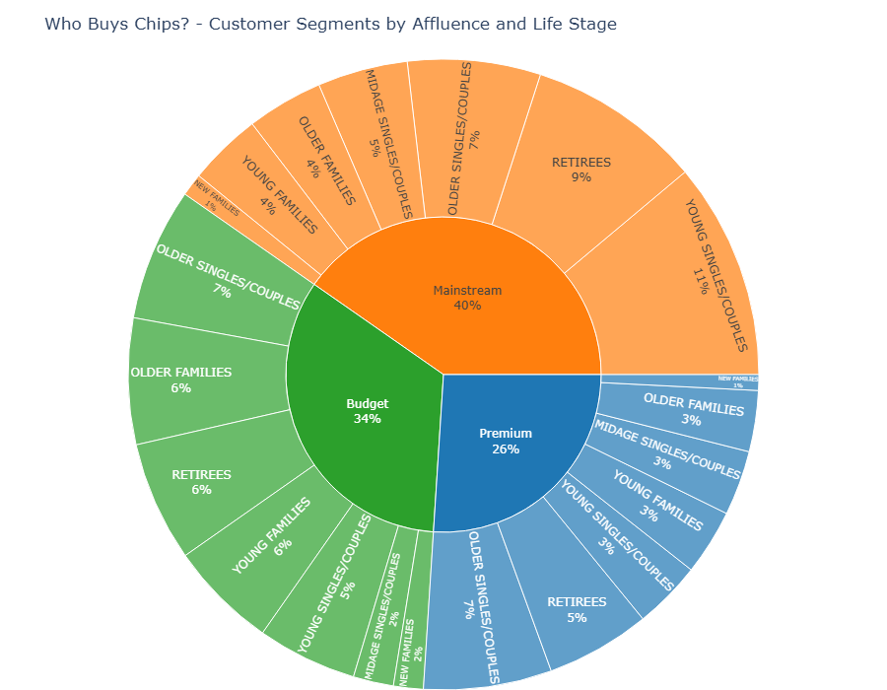
Proportion of Customers by Affluence and Life Stage
Mainstream and Budget customers are the largest segments across all life stages. Young Singles/Couples and Retirees show the greatest diversity in affluence. Premium customers are more concentrated in mid-age and older life stages. Marketing and assortment strategies should be adjusted to reflect both affluence and life stage for optimal targeting.

Slide 8
02
Trial store performance

Slide 9
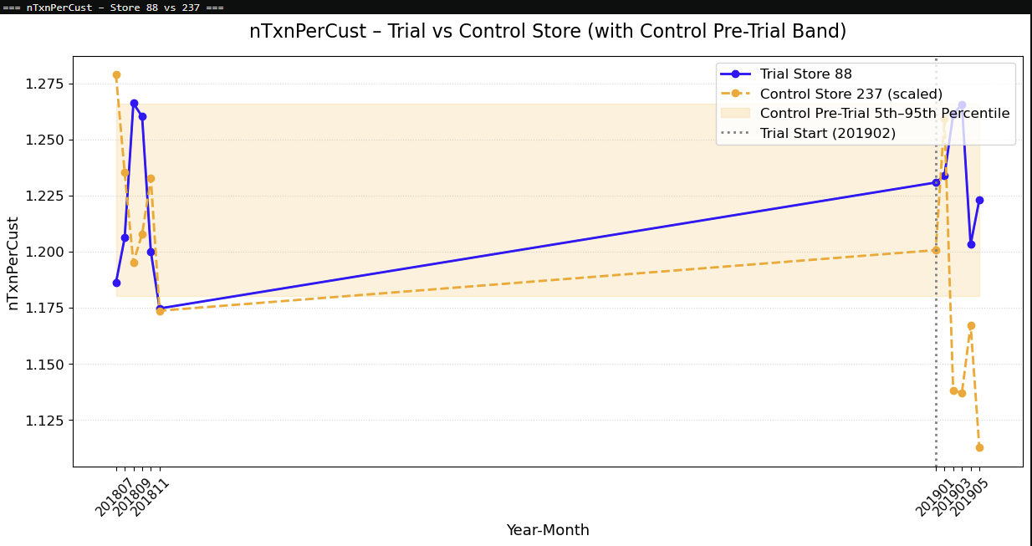
Explanation of the control store vs other stores
Average Transactions per Customer – Store 88 (Trial) vs Store 237 (Control) This chart shows monthly transactions per customer for the trial and control store, including a pre-trial confidence band. The trial layout in Store 88 resulted in a measurable increase in customer activity compared to both pre-trial performance and the control store.

Slide 10
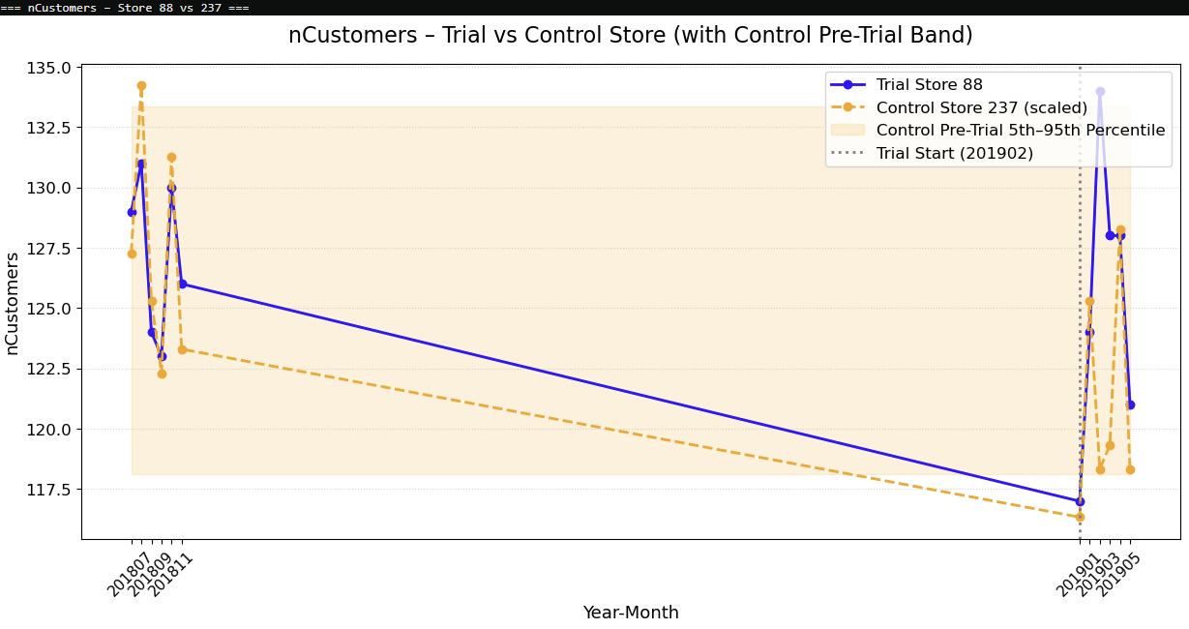
Trial Store Performance – Success Callout
Raised customer numbers from Feb–May in the trial store compared to control.
Performance remained consistently above the pre-trial normal range.
Strong evidence that the new layout led to increased customer visits and sales.
Recommendation: Consider rolling out the new layout to similar stores to capture further sales uplift

